Slide 1
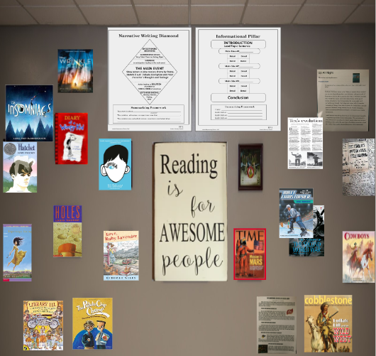
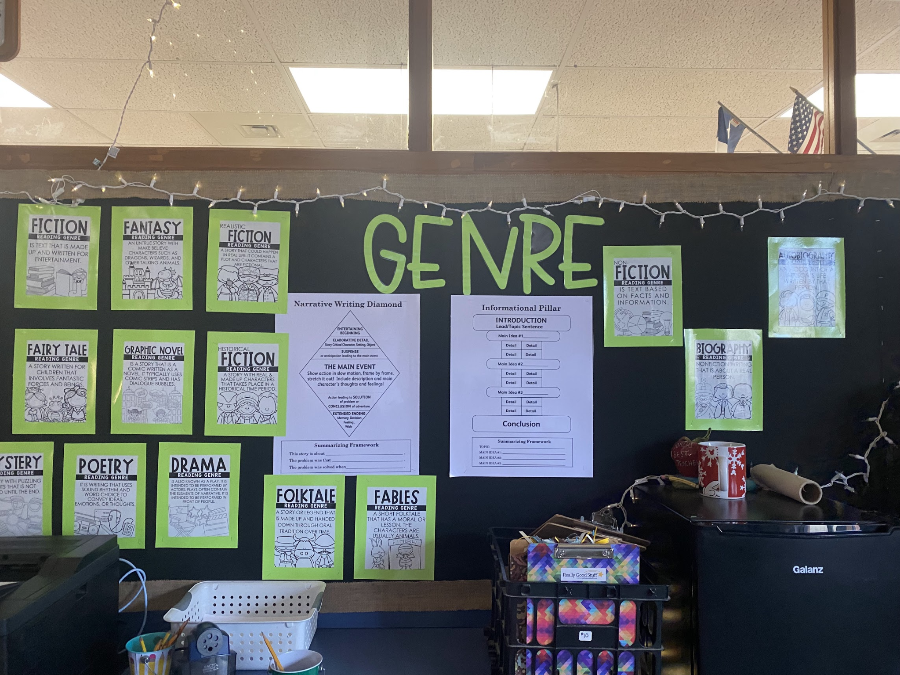
A book sort is a great jumping off point to start your unit on author’s purpose and genre at the beginning of the school year.Start pairing your side by side books or articles now! Make this idea your own by finding accompanying articles or nonfiction books that go with your favorite narrative books! Go one step further by linking to topics your students study in science and social studies.
Narrative/ Fiction Book
Informational/ Non-Fiction Book
-The title has the main
character’s name
or an experience in it
-The main character or
setting is on the cover
-Pictures are artistic in
Nature
-Organized following
the plot structure
-The title has the topic in it
-The topic is on the cover
-Pictures are realistic
-Organized with main ideas, facts, and details
Sub-Genres The sub-genres you introduce throughout the year also fall under these two organizational frameworks. It is important for students to make the connection that these subgenres are not organized differently necessarily, but that the salient features that are found within the text is what makes them different.

Slide 2
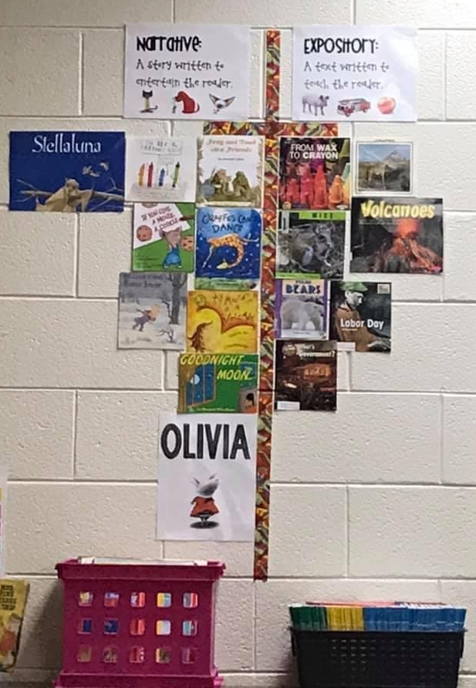
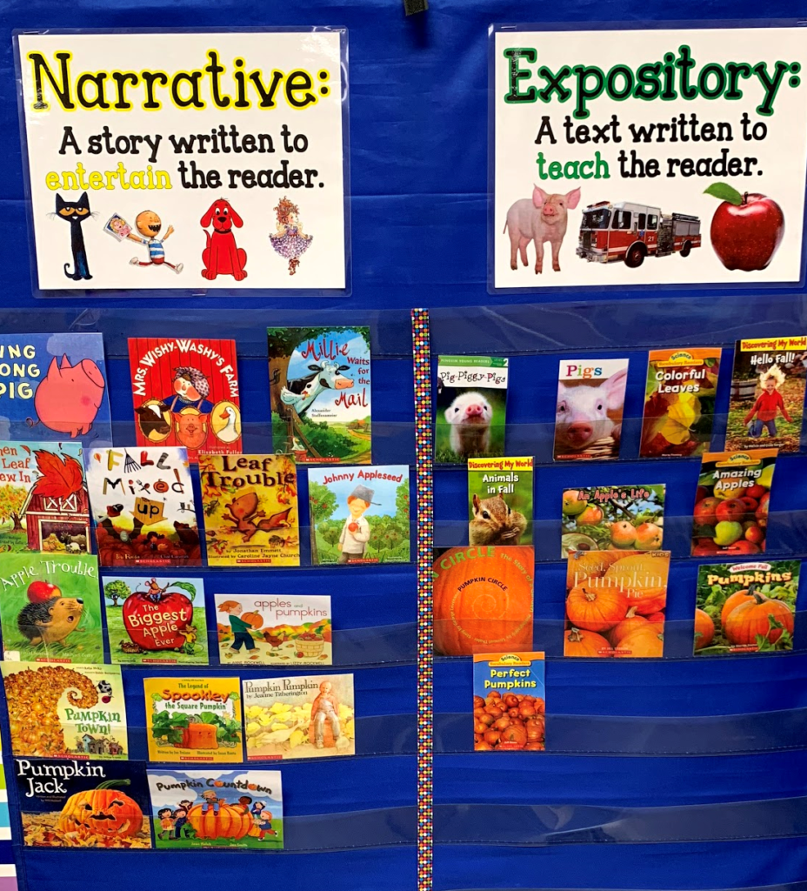
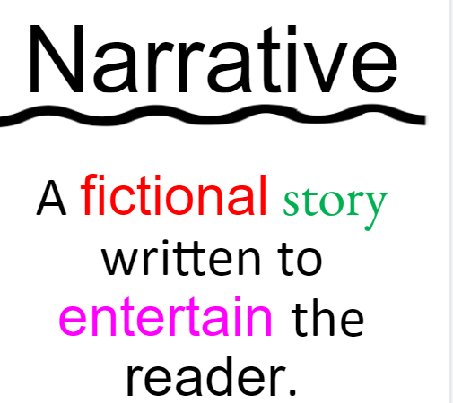
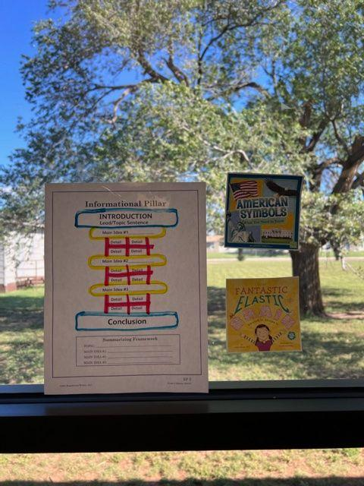
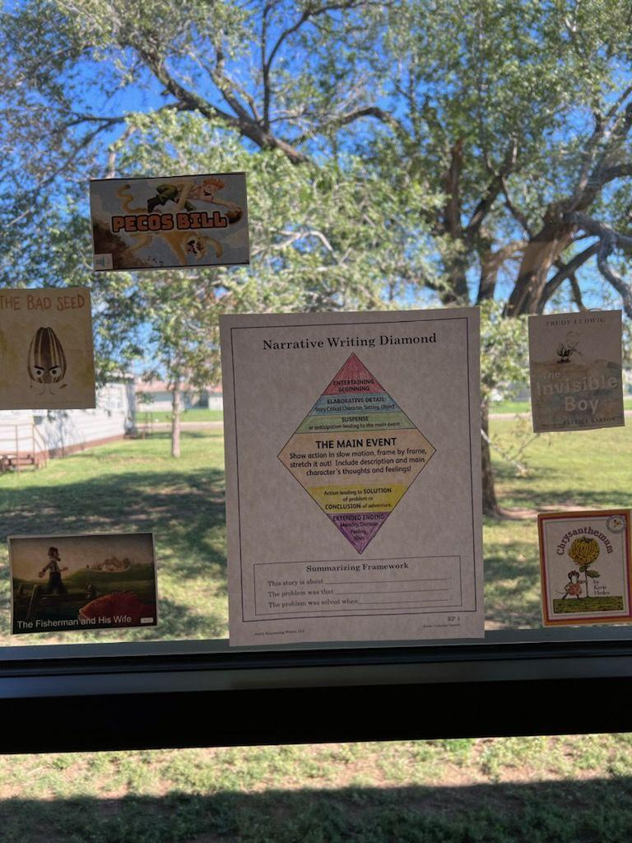
We know wall space is an issue for a lot of you! Look at this second grade classroom that used their classroom window for their sort!

Slide 3
In the book cover lessons, students recognize that the covers of books provide hints about genre. Key points to remember when presenting books are included for you in the notes section on the slides. Be sure to check out the skill power lesson and animated video on book covers in your Empowering Writers Guide! In this lesson, feel free to substitute out the titles for books you already have!
Present the book Lacey Walker Nonstop Talker (or another narrative book of your choice). Be sure to hit key points included in the notes for each slide.
Read the book.
Summarize the book together as a class using the EW Summarizing Framework. Students then add the summary in their book covers.
Using the blank narrative diamond on the inside of the book cover, students will draw the sequence of events that happened in the beginning, middle, and end of the story.
Finally, students glue or draw the book cover onto the front of the book they made.
Day ONE: Narrative Book Covers
Day TWO: Narrative Book Covers

Slide 4
Notes:
Teacher Notes: Narrative Book Covers:
Cartoonish picture, main characters are on the cover and sometimes their name are in the title. If it is character, problem, solution, there is a hint of a problem in the picture/title. EX: notice the frown on the dinosaurs face, the upturned chair and mess. The hint of a problem in the title: eat our classmates.The author’s purpose is to entertain the reader. The author does this throughout the story with problems that help the main character grow and change.

Slide 5
Book Cover Lessons can be found in your K/1 guide genre/summarizing section or in the Literacy Launch section of your Grade 2 guide.
Copy double sided with the next slide to make a foldable book.

Slide 6
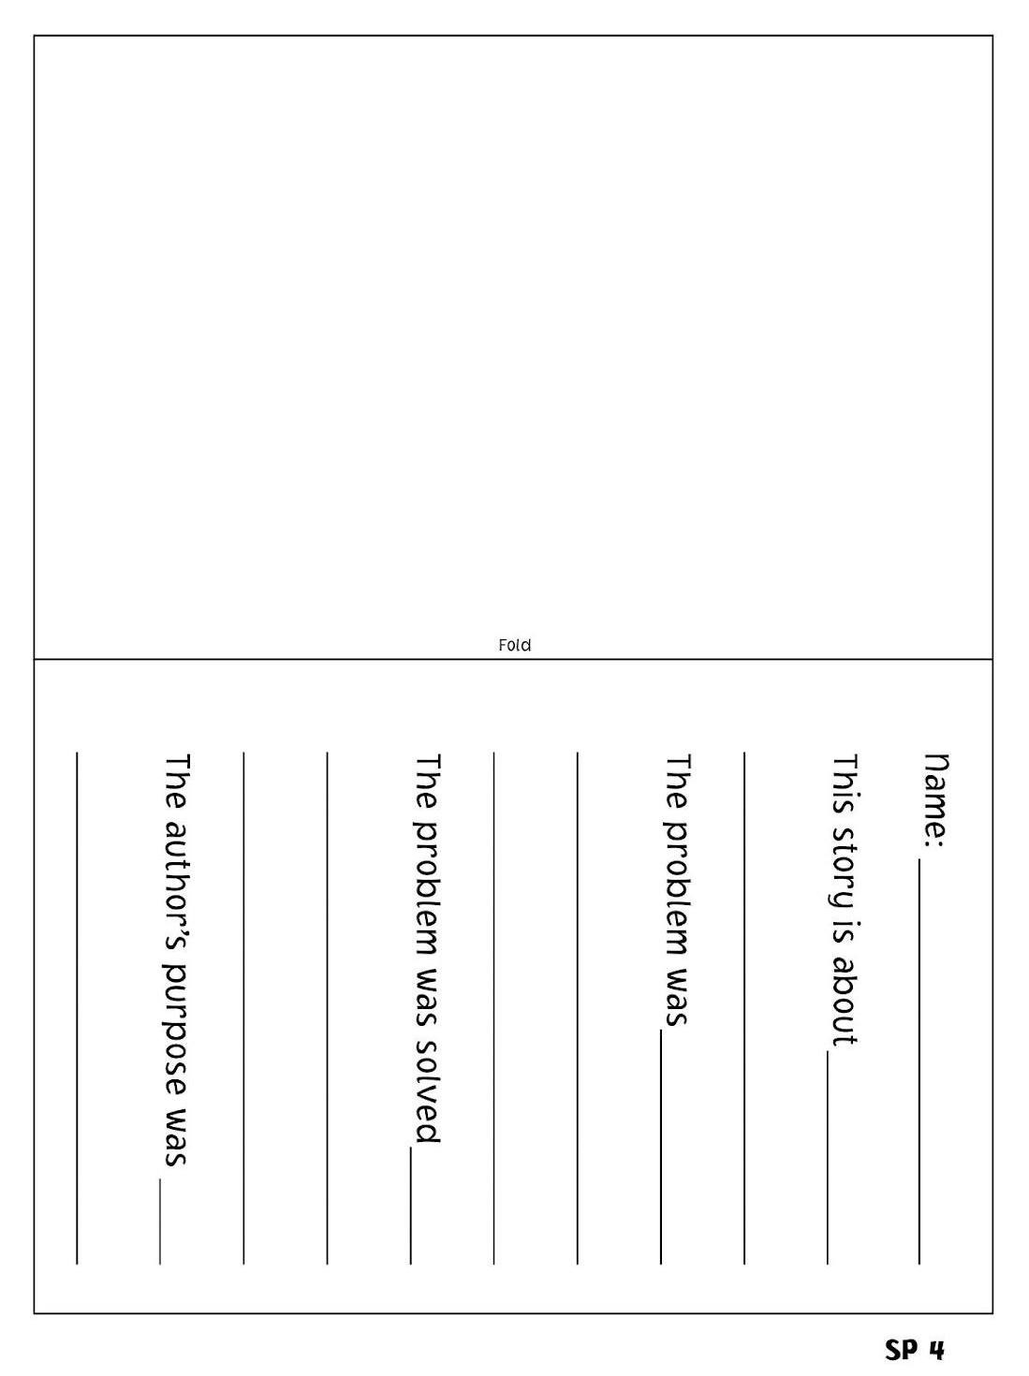
END
MIDDLE
BEGINNING

Slide 7
Copy and cut apart. Student then glue these on the cover of their books. ( You can have them draw their own if time permits)

Slide 8
In the book cover lessons, students recognize that the covers of books provide hints about genre. Key points to remember when presenting books are included for you in the notes section on the slides. Be sure to check out the skill power lesson and animated video on book covers in your Empowering Writers Guide! In this lesson, feel free to substitute out the titles for books you already have!
Present the book cover Owls ( or another nonfiction book). Be sure to hit key points included in the notes for each slide.
Read the nonfiction book.
Summarize the book together as a class using the EW Summarizing Framework. Students then add the summary in their book covers.
Using the summarizing framework on the inside of the book cover, pull out the topic learned about and write at the top. Then pull out three main ideas learned and add to the lines underneath. NOTE: Many nonfiction books begin to have several main ideas included in them. Have students only pick a few to begin with.
Then, students glue or draw the book cover onto the front of the book they made.
Day THREE: Informational Book Covers
Day FOUR: Informational Book Covers

Slide 9
Notes:
Teacher Notes Informational Book Covers:
Real or realistic picture found on the cover, a picture of what you will be learning about is on the cover and the topic you will learn about is in the title. The author’s purpose is always to inform the reader through real facts.

Slide 10
Copy double sided with the next slide to make a foldable book.

Slide 11
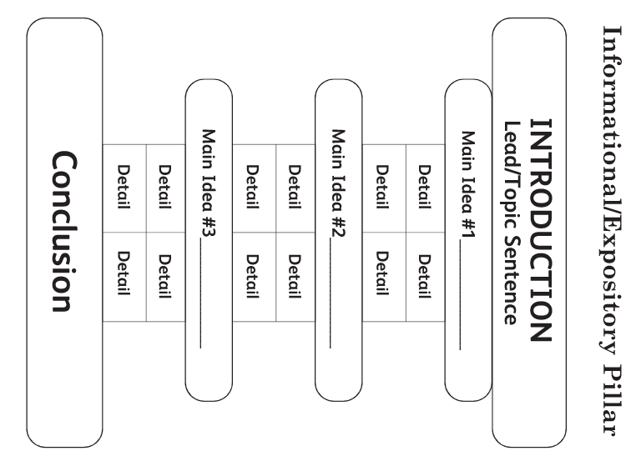
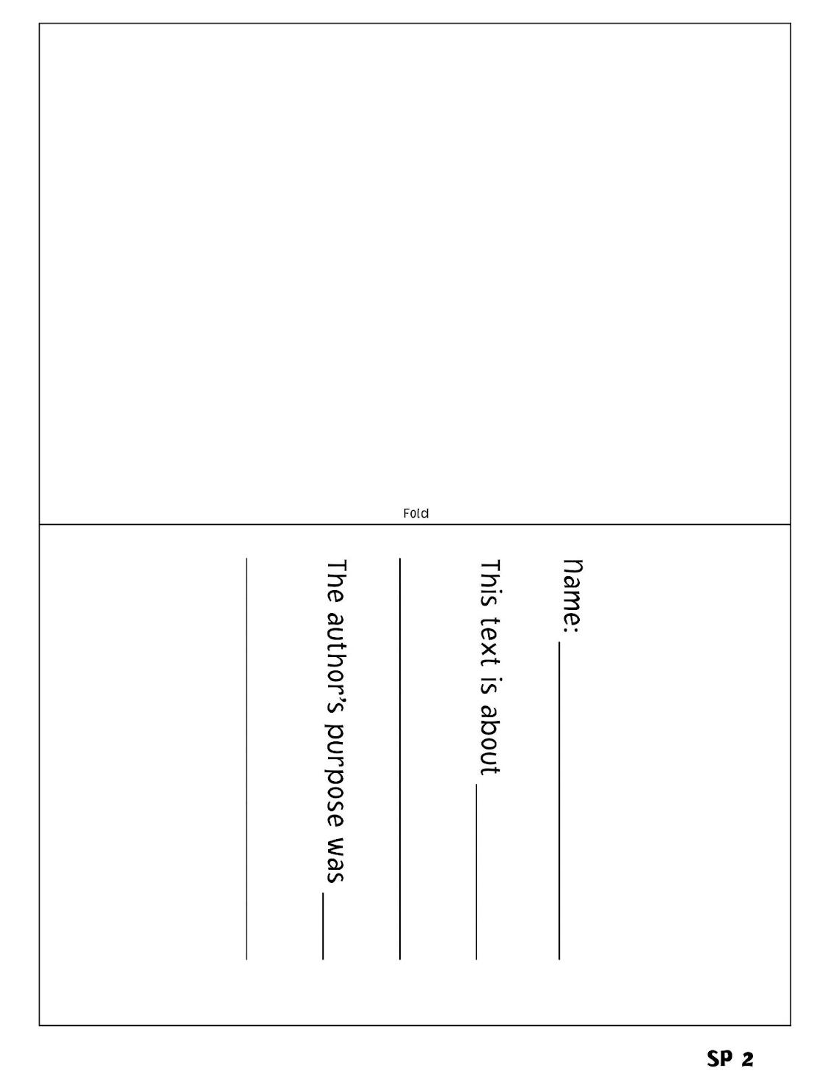
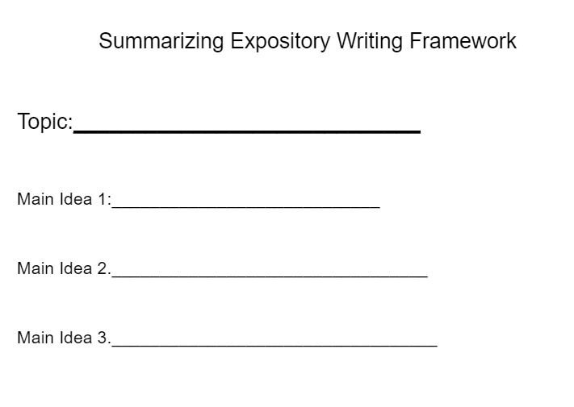

Slide 12
Copy and cut apart. Student then glue these on the cover of their books. ( You can have them draw their own if time permits)

Slide 13
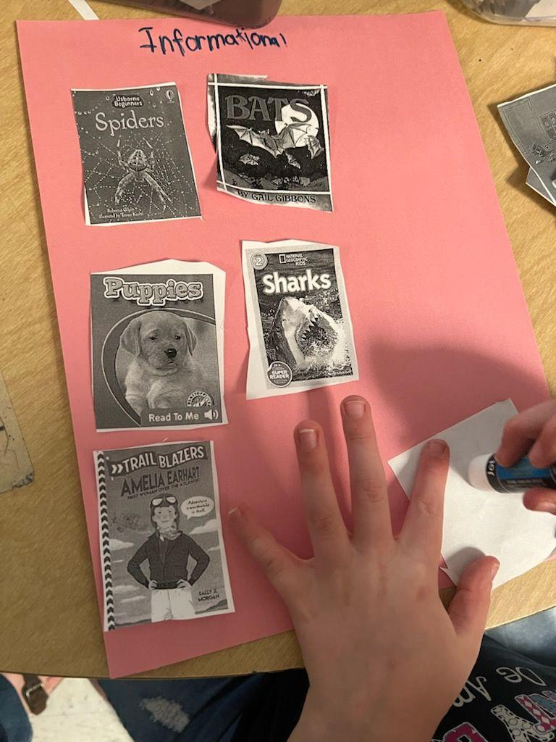
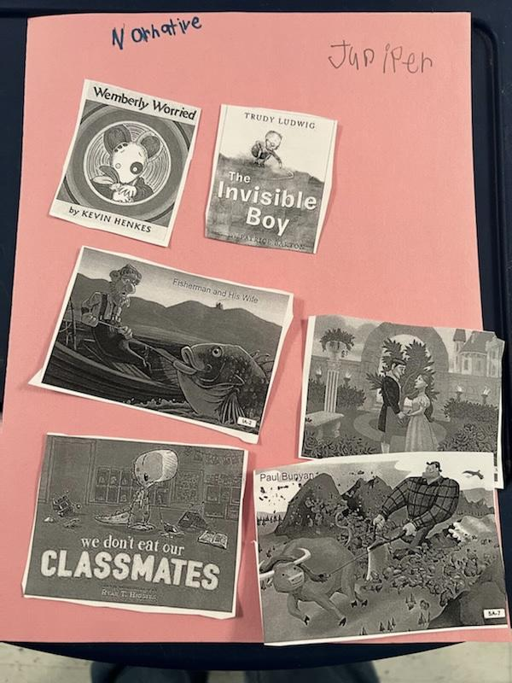
OPTIONAL STUDENT BOOK SORT CUT & PASTE:
Have students cut and paste book covers under the correct genre as a quick check at the end of the week, making sure they understand the difference between the two.
Remember: These lessons are meant to be continued all throughout your year. Each time your interact with text, you are having this conversation about genre, author’s purpose, and organization.

Slide 14
After you have cut out your book covers, glue them onto the paper under the correct genre.
Notes:
At the end of the week, have students cut and paste the appropriate book covers under the correct genre as a check for understanding on the lessons you have taught on gener, organization, and author’s purpose.

Slide 15
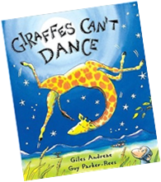
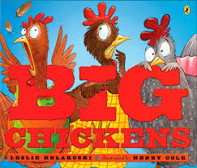
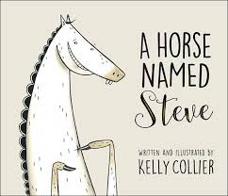
Run copies and cut in half for students to cut apart and paste onto their genre sort paper.

