Slide 1
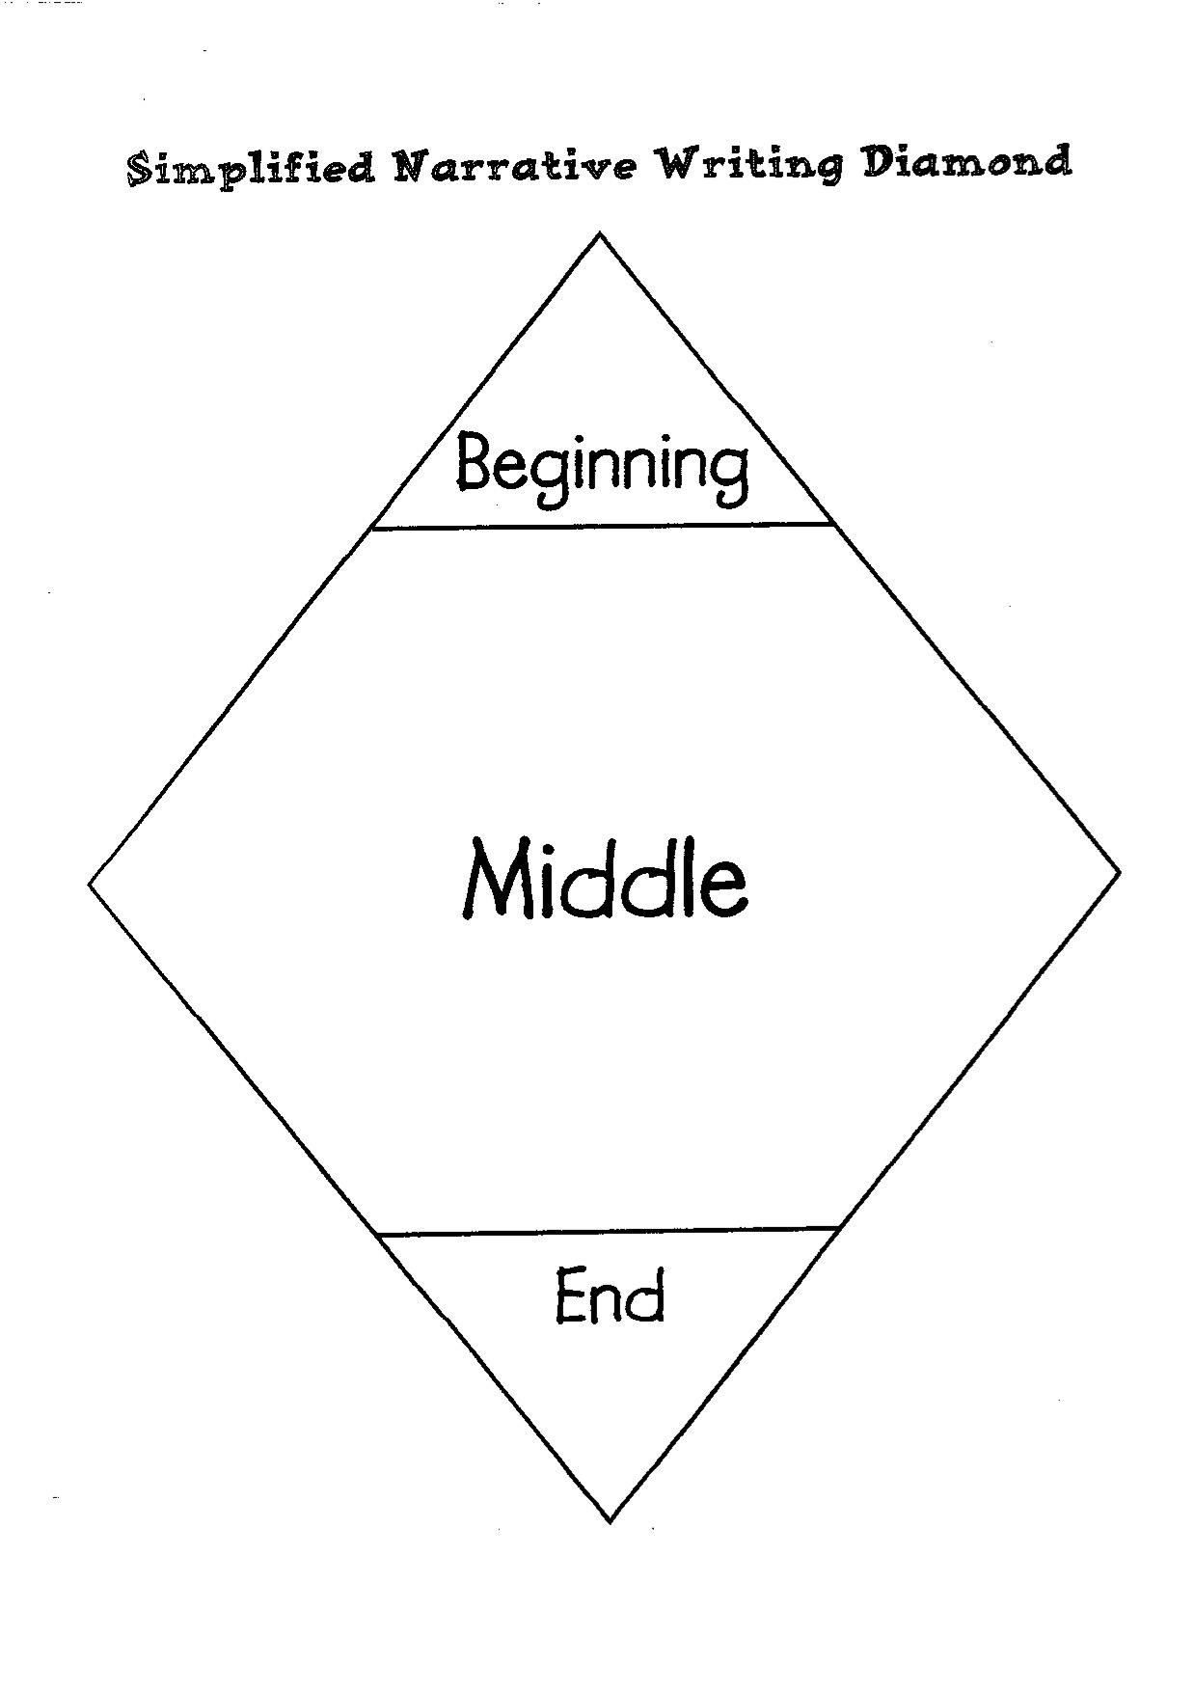
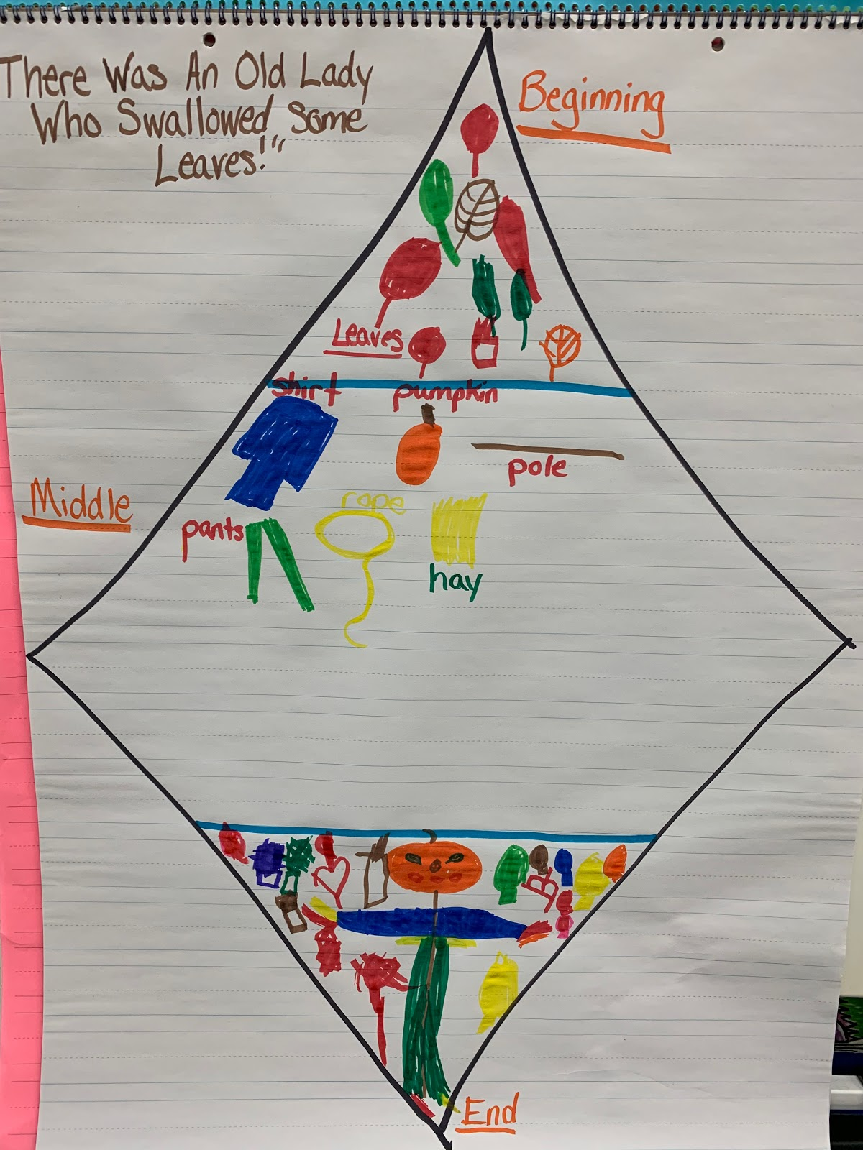

Look at the SIMPLIFIED WRITING DIAMOND, used in both Kindergarten and grade 1.
In this lesson, students will begin to see the SIMPLIFIED WRITING DIAMOND as a representation of the shape narrative stories take.
• Point out that the beginning and ending parts of a story are small and the middle (MAIN EVENT) is the largest part of the story.
• As you teach the corresponding skills throughout the year, you will refer to the simplified diamond.
• The diamond is not a rigid rule or formulaic pattern, but a basic guide to help students channel their creativity into what others recognize as story.
• Students need lots of experience talking about stories they have read and how the author extends the middle, by stretching it out. If there is a problem, they should discuss all the things that the character does to try to solve the problem. If there is an adventure or experience, they should discuss each step of the adventure as it progresses.
• Always refer to the diamond pointing out that the MIDDLE of the story is the LARGEST, most important part of the story.
Ask: “In the middle of There Was an Old Lady Who Swallowed Some Leaves, what was the problem?” she swallowed too many fall things.
Now, open the book and point out the middle of the story where the old lady is swallowing the items. Count the page numbers. Point out that the author spent ___ # of pages in the middle of the story. Reference this technique as “stretching out the middle”.
Next, model drawing and filling in the narrative diamond from the events in the book. Showing what happened in the beginning, middle, and end.

Slide 2
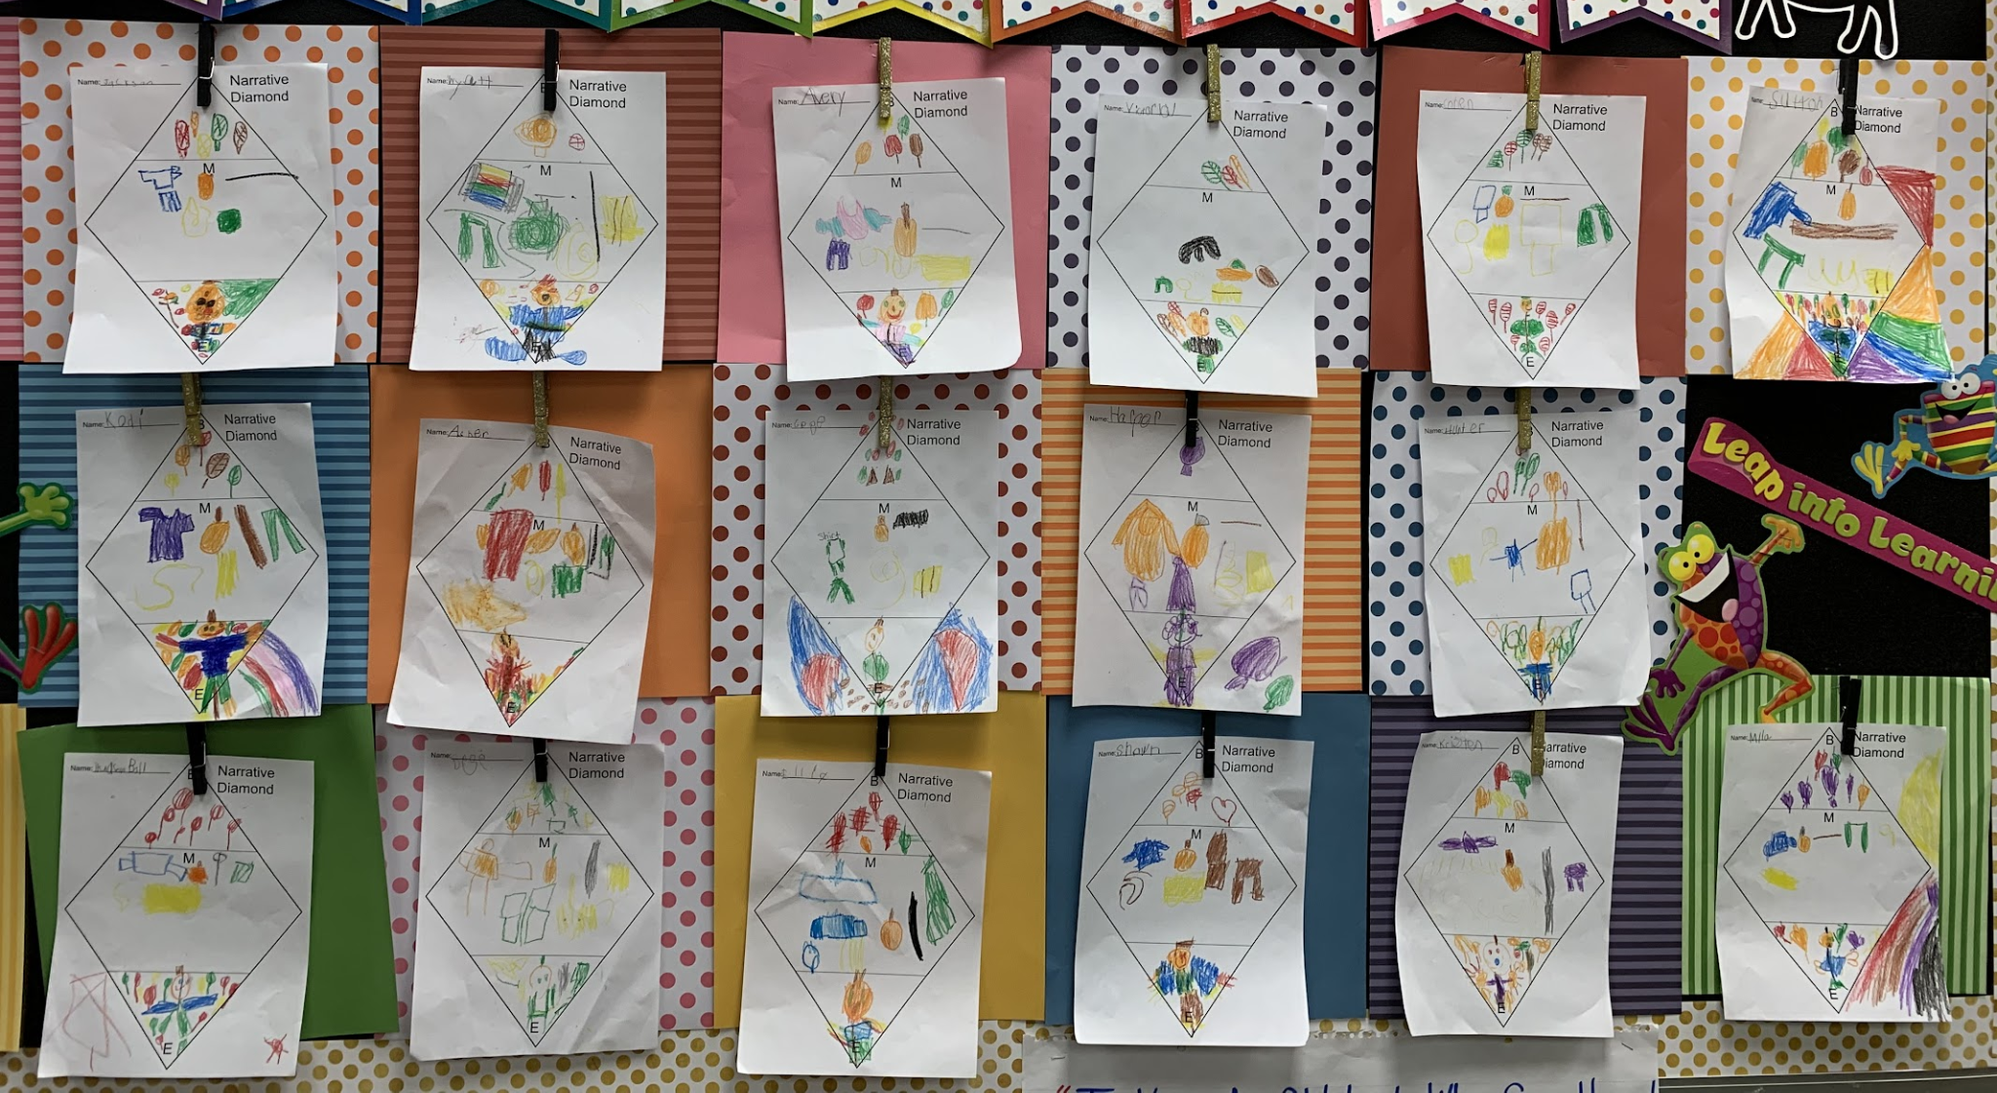
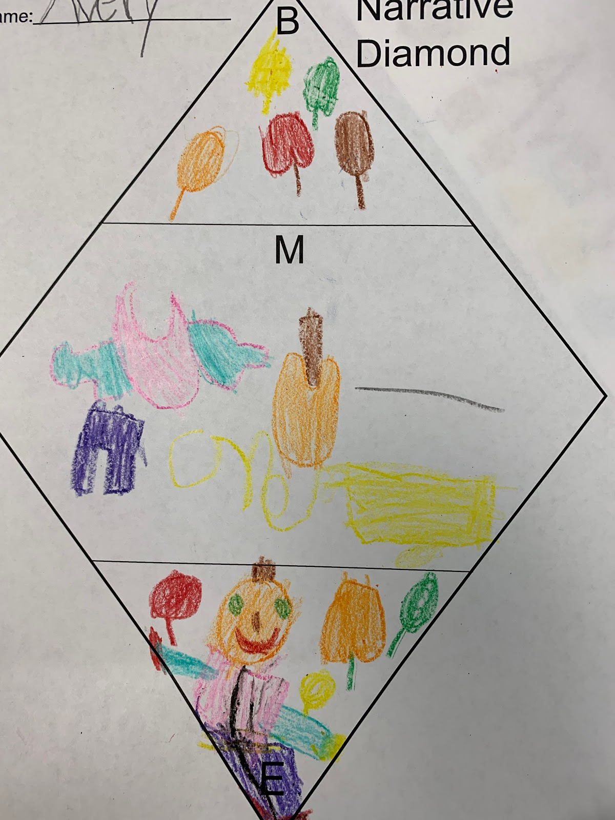
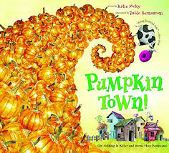
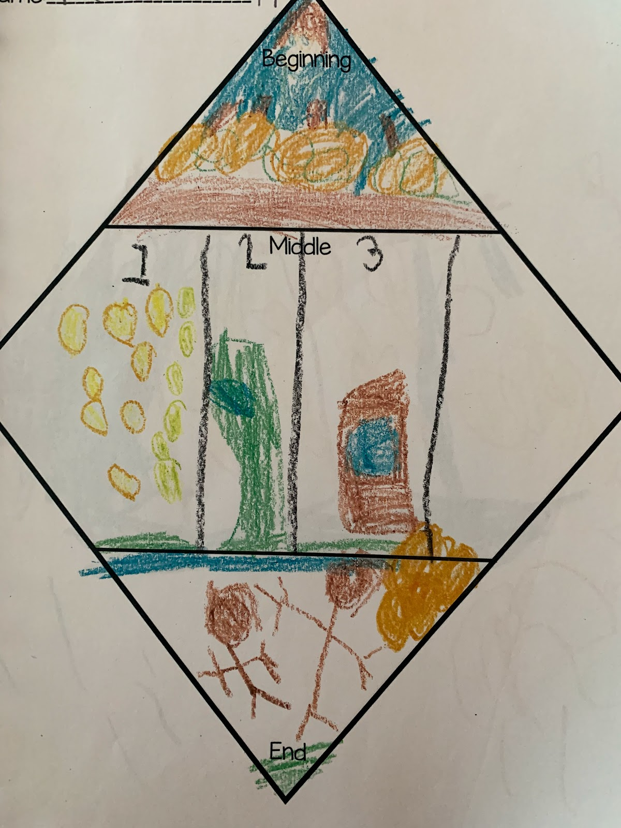
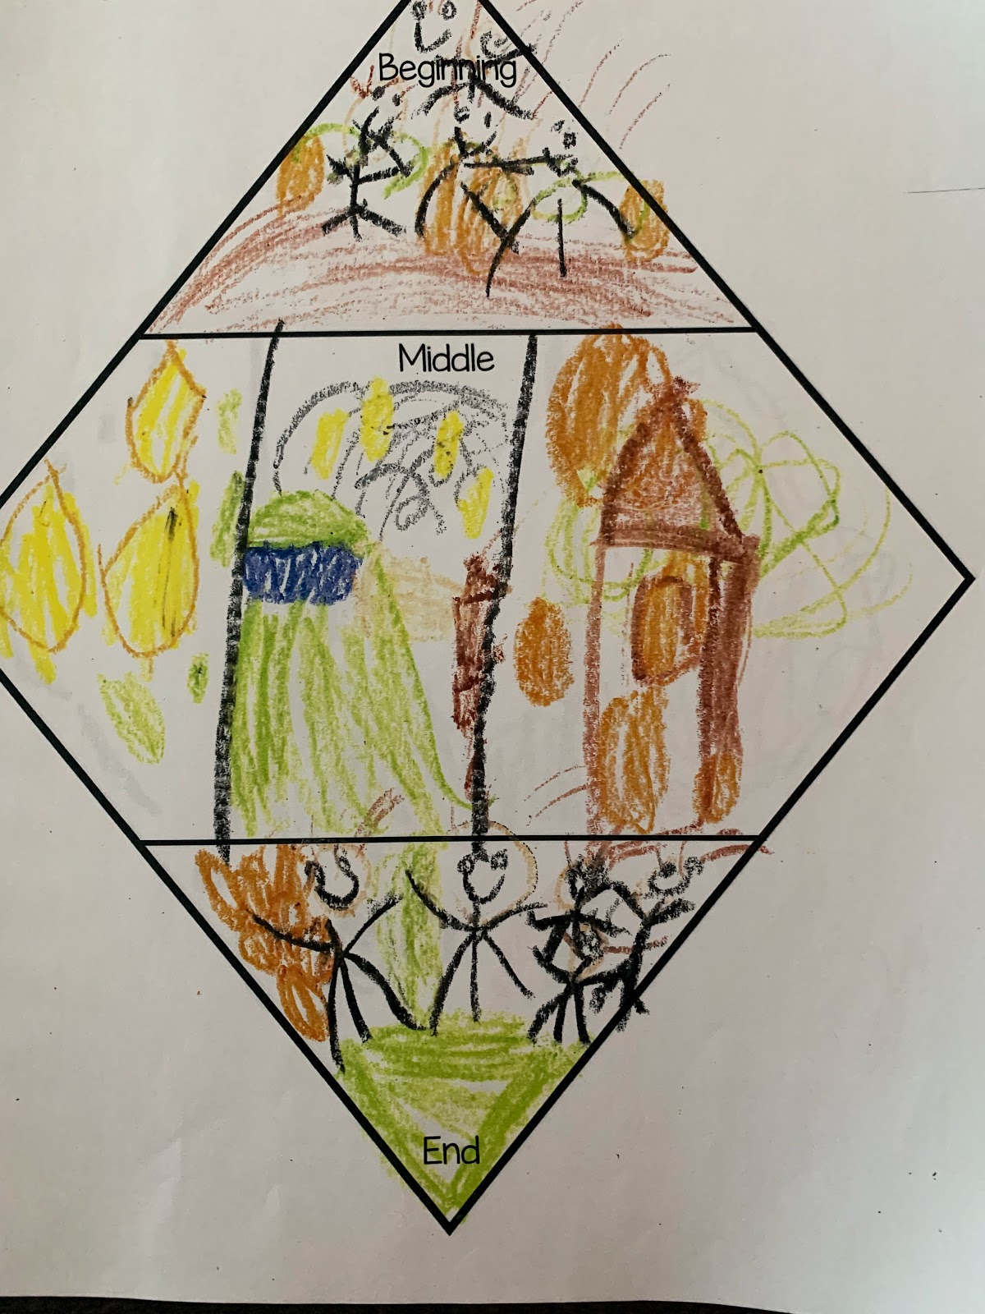
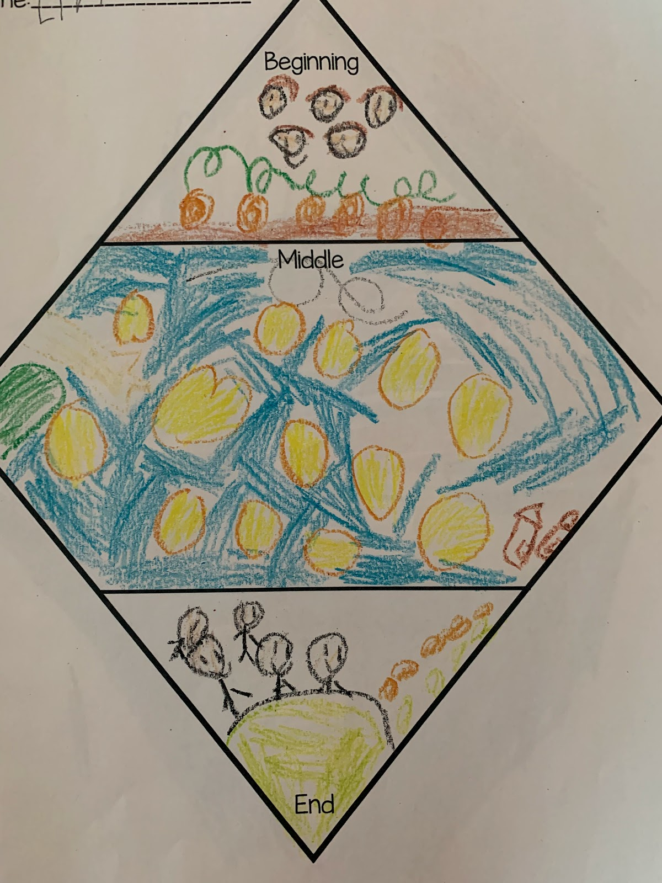
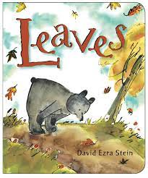
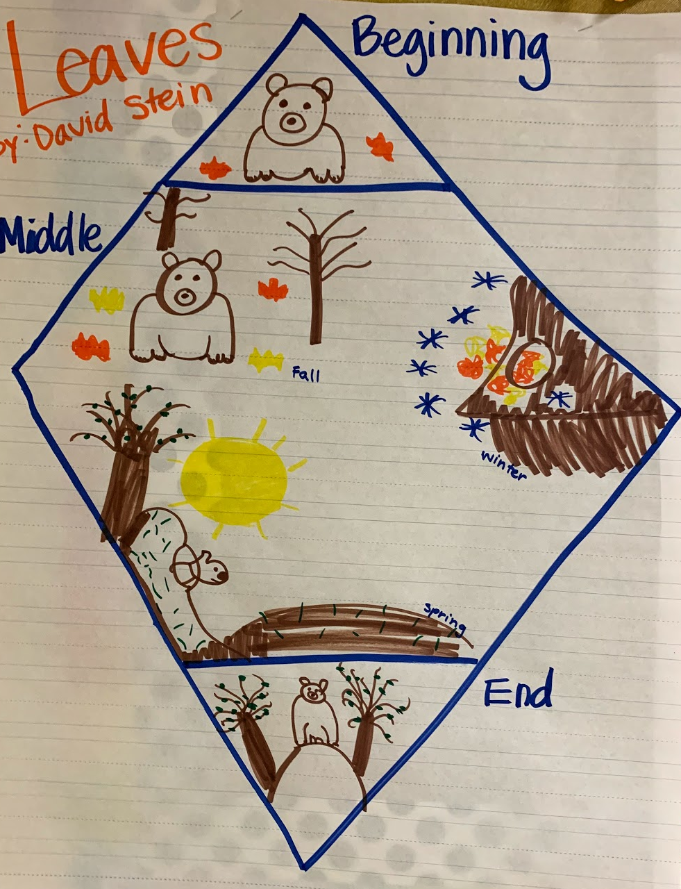
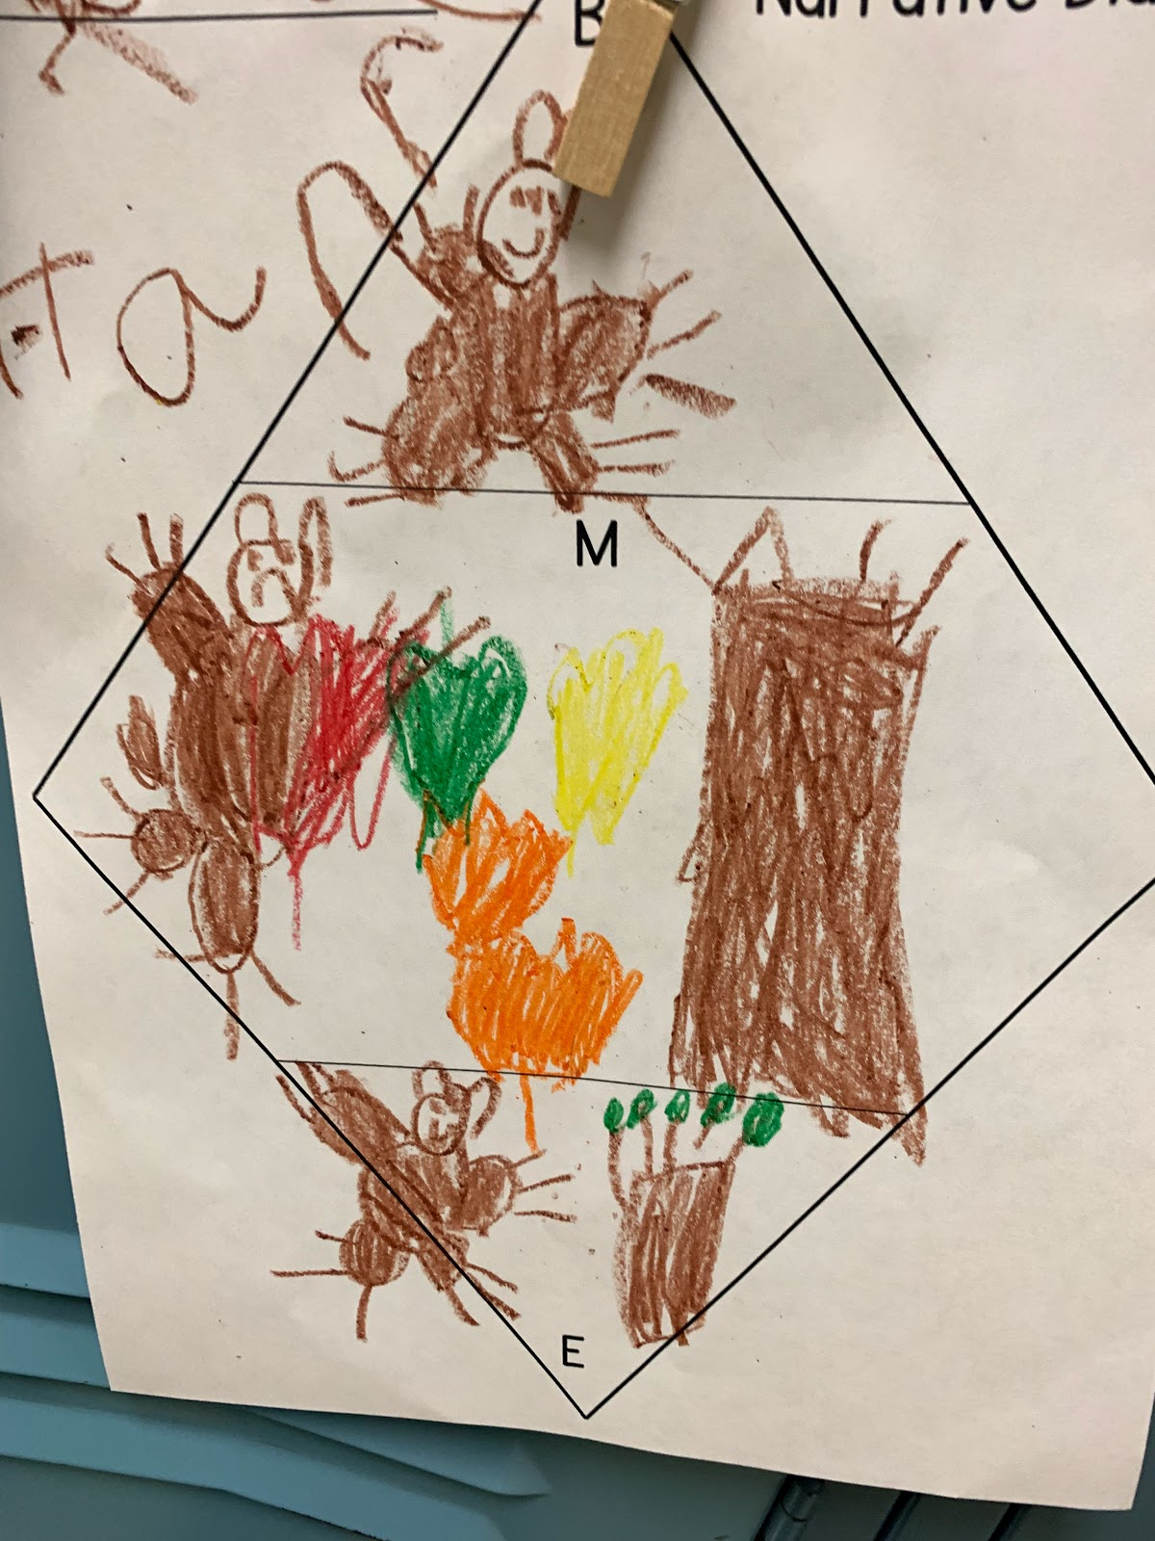
Then, distribute the simplified narrative diamond, for students to draw on their own, depicting what happened in the beginning, middle, and end of the story.
Use this for any narrative story you have planned this fall!

