Slide 1




Somebody Loves You, Mr. Hatch
Teachers- In this lesson, students will read Eileen Spinelli’s book Somebody Loves You, Mr. Hatch, then choose a person in the school to write a note of thanks to. They will elaborate through the use of the two basic detail-generating questions: What does it look like? and Why is it important?. This is a great way to teach students how to show appreciation to important people in their lives.
*Delete this slide before sending to students
*Students can write their final copy on the linked pdfs.
Click on either or for 2 different options.
*Feel Free to edit any slide by adding, deleting, or changing the bitmoji.

Slide 2
Somebody Loves You, Mr. Hatch
Students- In this lesson, you will show appreciation to someone in your school by writing them a note of thanks. You will elaborate through the use of the two basic detail-generating questions: What does it look like? Why is it important?.
Directions:
Listen to Somebody Loves You, Mr. Hatch.
Identify people in your school that you appreciate and select one person to write a thank you note to.
Use the detail generating questions to help gather information about that person.
Combine that information with sentence starters to write your note.

Slide 3

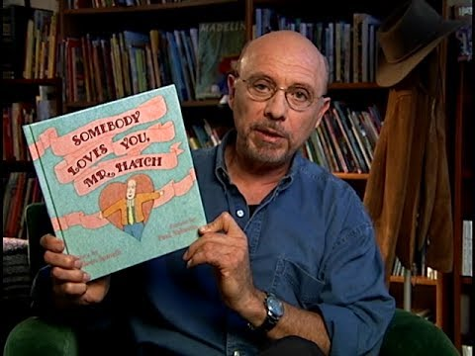

Listen to the story!

Slide 4
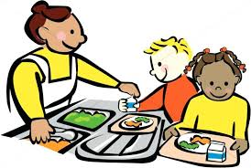



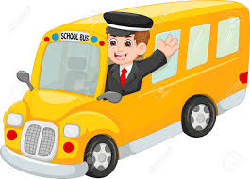
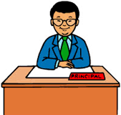
List people at school that you come into contact with each day. (teachers, nurse, cafeteria workers, principal, bus driver, custodian, etc.)
Type here
Drag the star next to the person you choose to write a thank you note to.

Slide 5
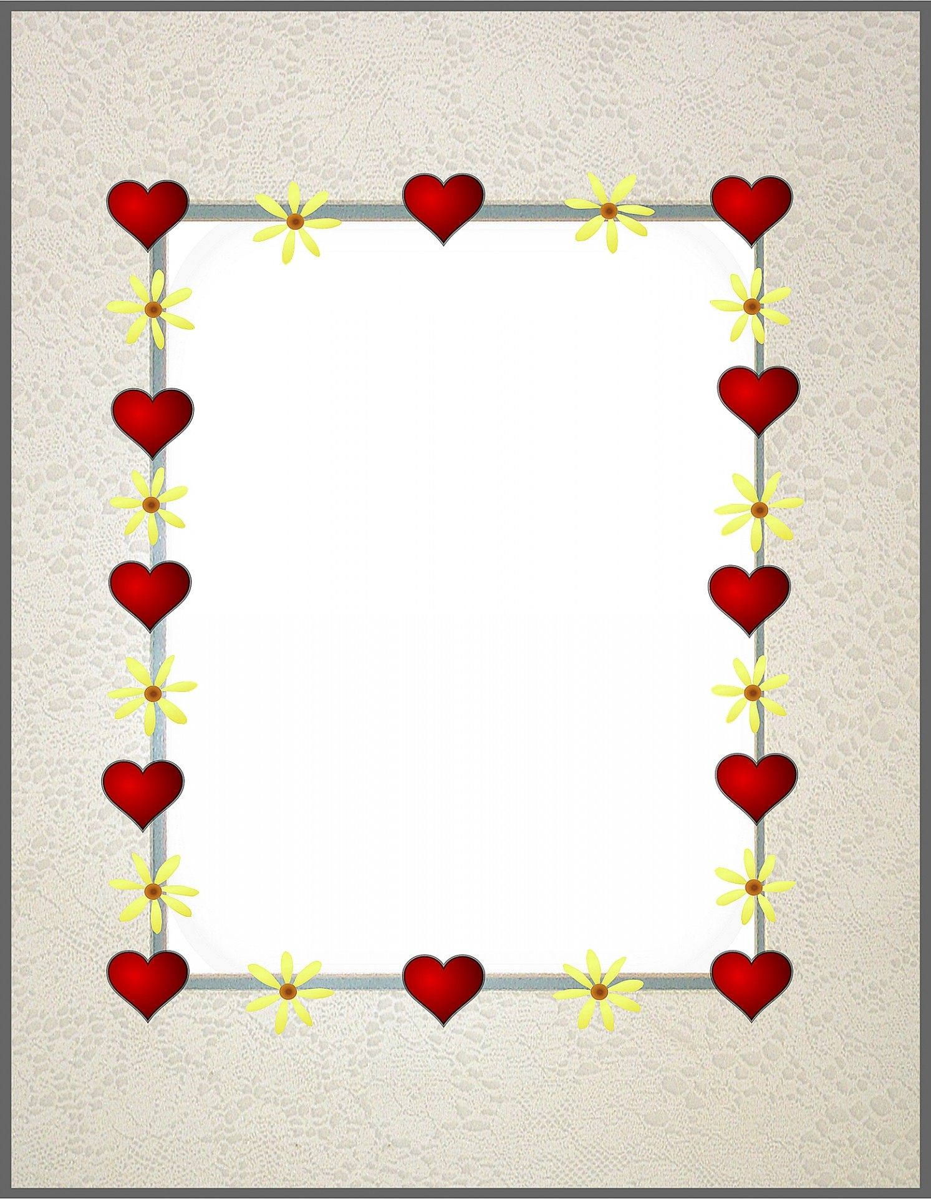
Remember the Detail Generating Questions?
What does it look like?
Why is it important?
These questions help us to “show” rather than “tell” in our writing!
When describing a person, “What does it look like?” might explain the thoughts, feelings, actions, or behaviors that the person exhibits.
“Why is it important?” could be what you learn or receive from that person.
Let’s look at an example on the next slide!

Slide 6
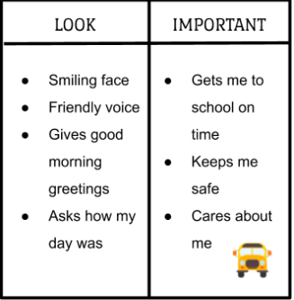
The Bus Driver

Slide 7
I am writing to ________________.
Complete the chart!
LOOK | IMPORTANT
Type here | Type here
Click to go back to the bus driver example chart.

Slide 8
Now, combine your ideas with the sentence starters provided to write your note. Click the bus driver to see an example.
Type here
Sentence Starters--
I am lucky to have a…
I notice when…
Without you, I’d never be able to…
I appreciate your…
Having a (bus driver, nurse, etc.) like you…
Thank you for being someone who...
Try one of these for a closing sentence--
I hope on this special day…
I want you to know how much I appreciate…
I will always be thankful for…
Our school is a better place with you!
Thank you for always...

Slide 9
You always have a smiling face and a kind greeting for me each day. Not only do you make sure I get to school on time, but you also make sure that I am safe when I travel with you. I am lucky to have you as my bus driver because you always make sure that all of your riders are kind to one another. This shows how much you care about each one of us. I hope that on this special day you know how much I appreciate you.
Click the heart to return to your note.

Slide 10

Optional
Choose someone in your personal life to write to as well. (mom, dad, coach, friend, etc.) What a great way to spread a little kindness in as many places as you can.
Remember: If it can make a difference to Mr. Hatch, it can make a difference to anyone!

