Slide 1


Teachers-
In this lesson, students will generate a diamante poem using a springtime theme. They will incorporate parts of speech and word referents as the building blocks of this type of poetry!
*Delete this slide before sending to students.
**Feel Free to edit any slide by adding, deleting, or changing the bitmoji.

Slide 2
Students-
In this lesson, you will generate a diamante poem using a springtime theme. You will incorporate parts of speech and word referents as the building blocks of this type of poetry!
Directions:
Review the poetry concepts on the next slide.
Read an example diamante poem.
Listen to the book Everything Spring.
Determine a springtime theme for your own diamante poem.
Write your poem and add images of your theme.

Slide 3
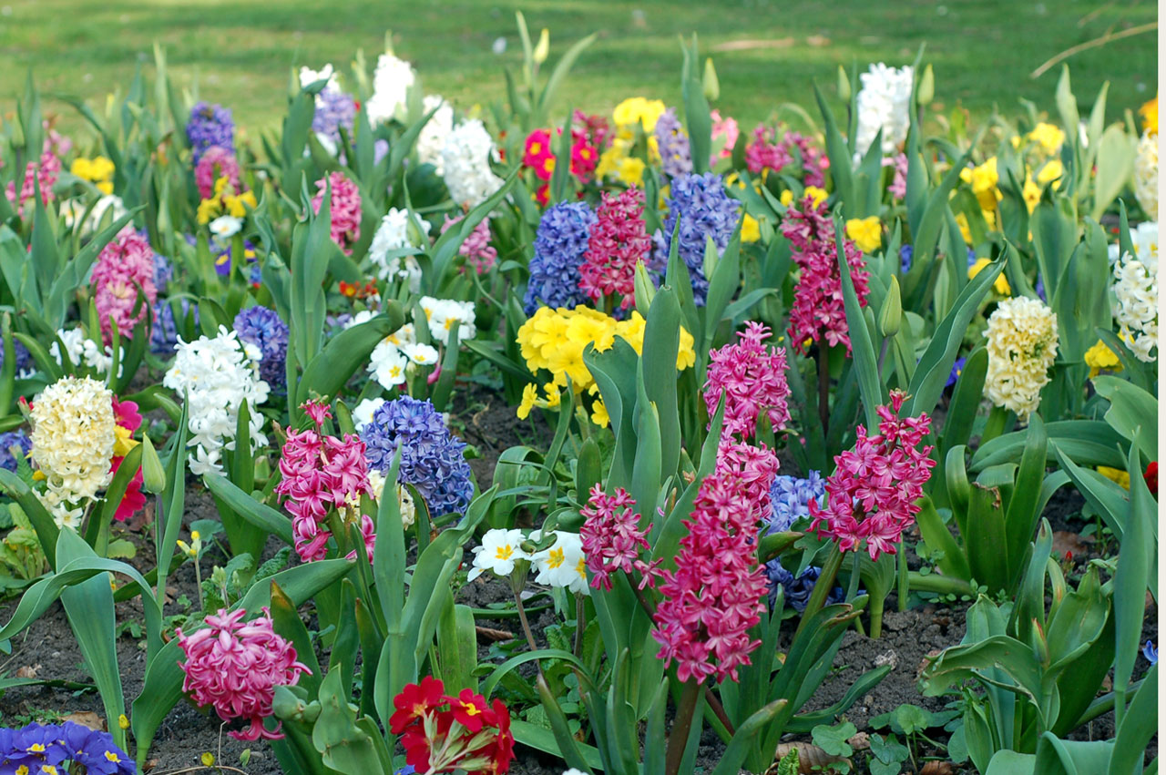
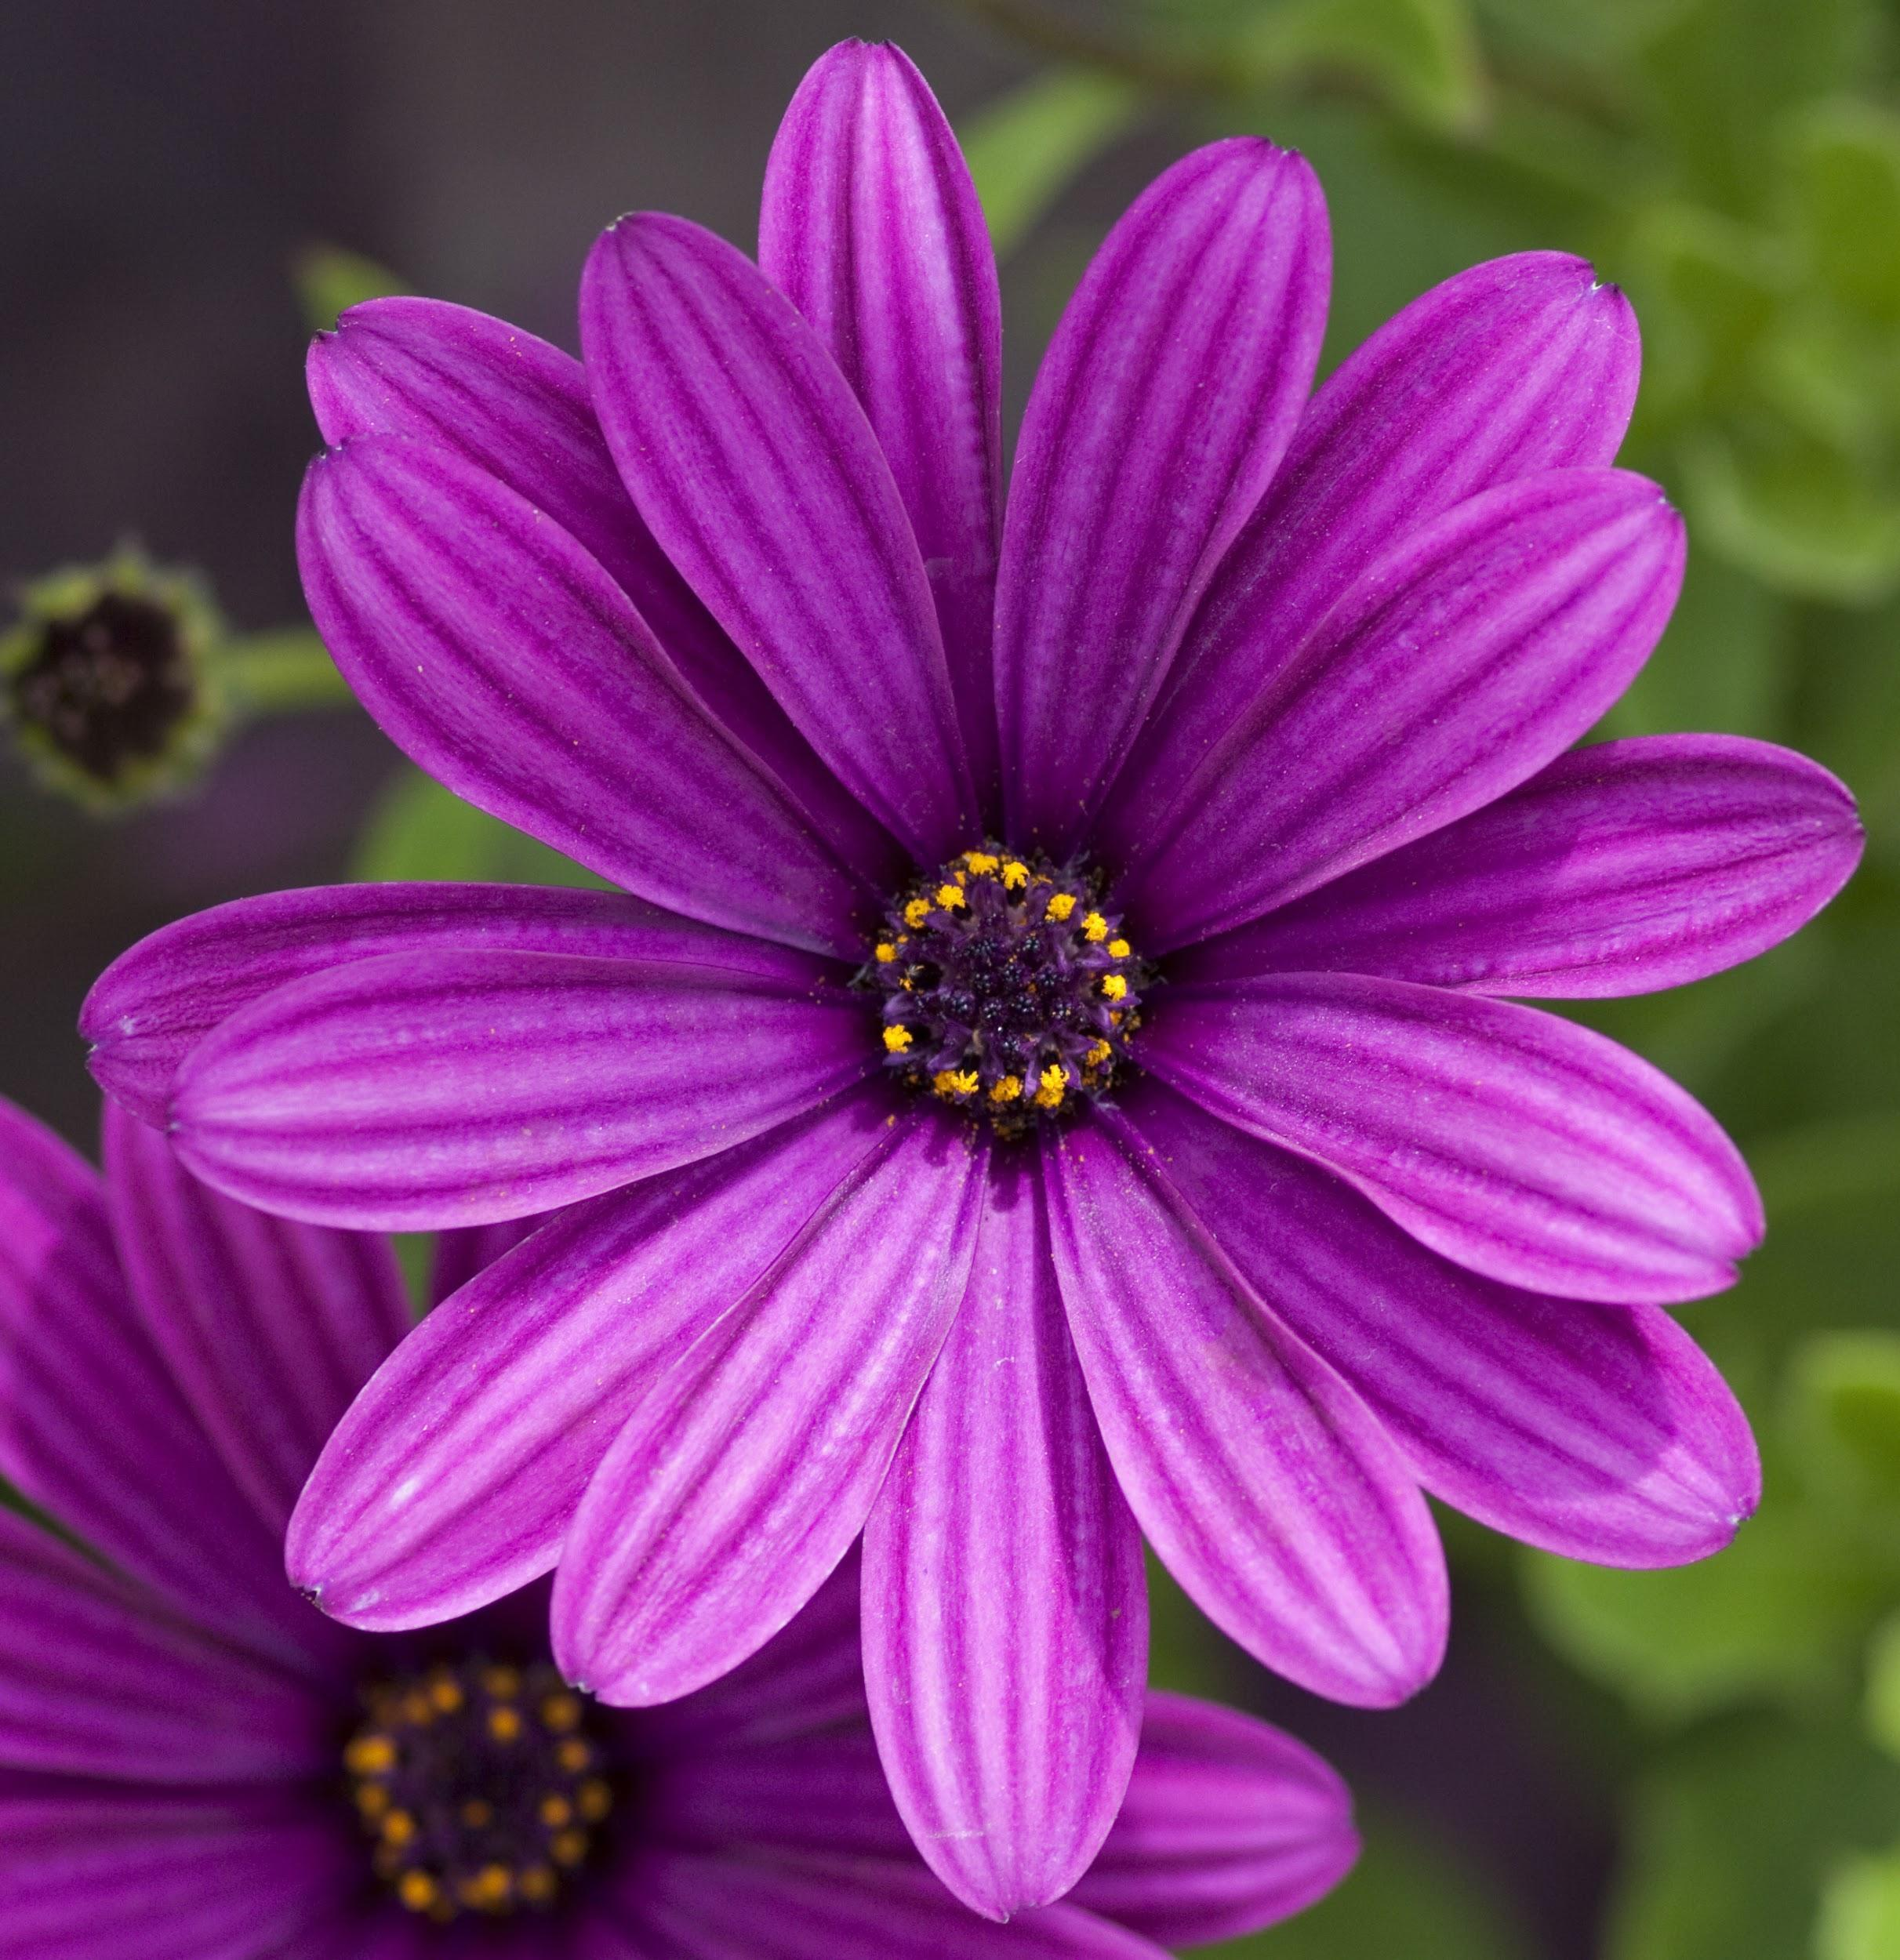
How poems are different than other forms of writing?
A poem is a form of writing designed to paint a picture of impression with words. Poets use rhythm, rhyme, figurative language, and word patterns to draw the reader or listener in. Not all poems use rhyming words. A diamante poem is one example.
“Diamante” refers to the diamond shape that the text of this kind of poem takes. The diamante poem consists of seven lines:
Line 1: a single noun
Line 2: two adjectives
Line 3: three verbs
Line 4: four nouns
Line 5: three verbs
Line 6: two adjectives
Line 7: a single noun (a word referent for the noun in line 1)
Click the flower below to see an example diamante poem.

Slide 4
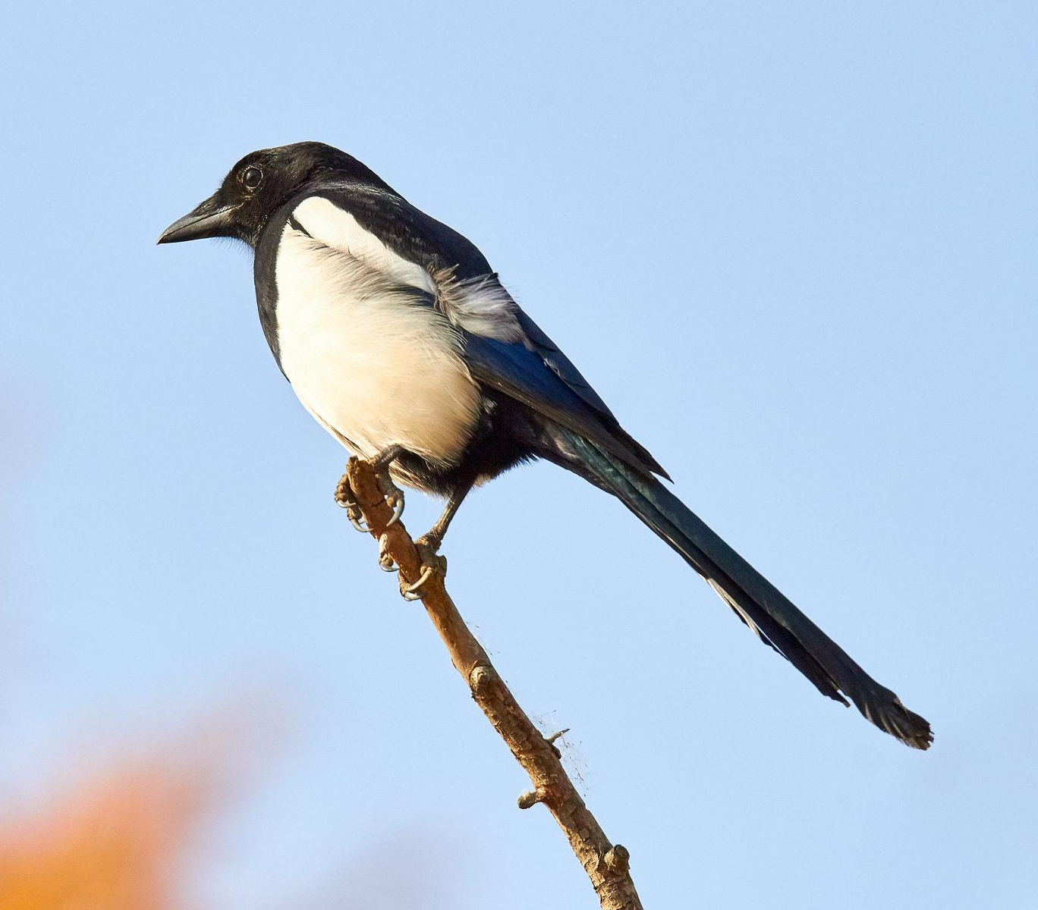
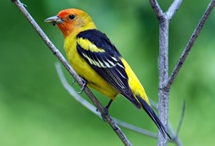
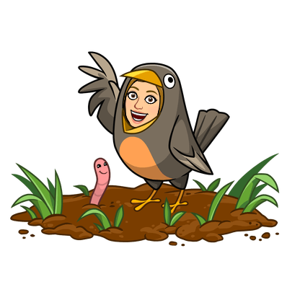
Springtime Theme:
Birds
Bird
Noisy, Hungry
Singing, Flying, Nesting
Feathers, Wings, Beaks, Tails
Perching, Soaring, Pecking
Cheerful, Busy
Chirpers
noun- a person,
place, or thing
adjectives- describing words
verbs- action words
Nouns associated with the topic
verbs- action words
adjectives- describing words
noun- a word referent for the noun in line 1

Slide 5

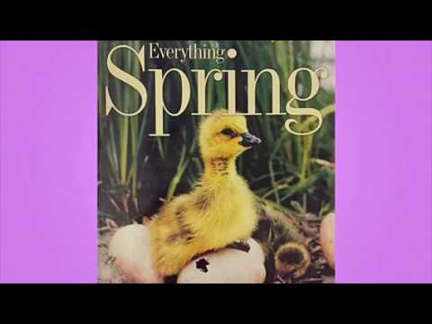
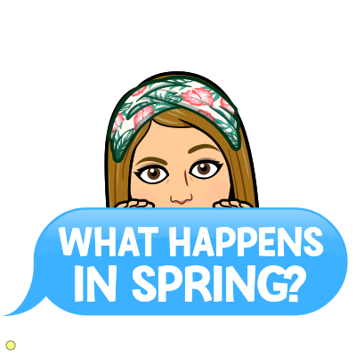
Listen to National Geographic Kids: Everything Spring by Jill Esbaum.
What would make a good springtime theme for your own diamante poem?

Slide 6
Now, it’s YOUR TURN!
Here are some other springtime themes to consider or you can come up with one of your own!
Flowers Baseball Bee
Butterflies Gardens Picnics
Rainbow Bunnies Rain
The theme I choose for my diamante poem is
_____(type here)______.

Slide 7
Now create your own diamante poem for the theme you selected on the previous slide using the template below.
*Insert an image of your theme here.
______
______, ______
______, ______, ______
_____, _____, _____, _____
______, ______, ______
______, ______
______
noun- a person,
place, or thing
adjectives- describing words
verbs- action words
Nouns associated with the topic
verbs- action words
Click the bird below to return to the example.
*Insert an image of your topic here.
adjectives- describing words
noun- a word referent for the noun in line 1

