Slide 1
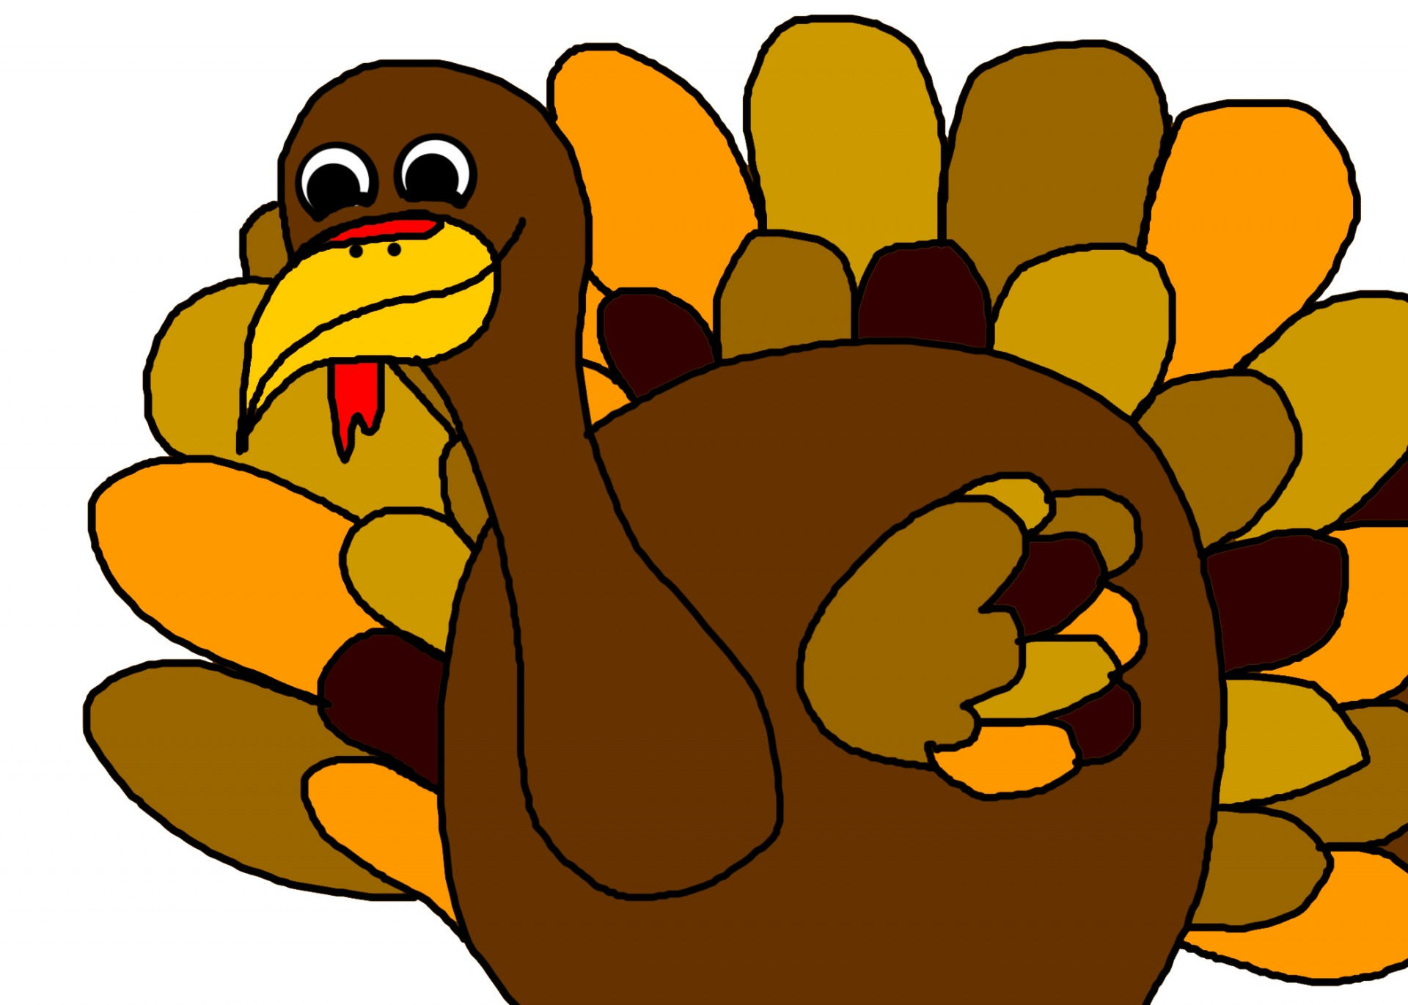
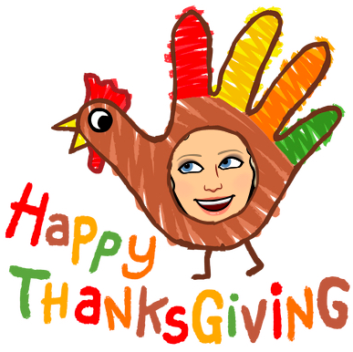
Hi Teachers!
Feel free to add any additional directions to the slides or delete any of the elements for your students - including the Bitmojis!
Delete this slide before sharing it with students.
Story Elements:
Main Character
Setting
Problem
Solution
Theme
GOBBLE, GOBBLE… Thanksgiving is just around the corner, and we are all pulling out the turkey books!
In this lesson, students will analyze story elements using the story, Turkey Trouble.
To differentiate this lesson, pair students up and have them orally go over each of the story elements after reading the story. Using the story elements cards, they can take turns asking the questions and answering them using the sentence starters as an oral practice.

Slide 2

Story Elements:
Main Character
Setting
Problem
Solution
Theme
GOBBLE, GOBBLE…
In this lesson, you will analyze story elements using the story, Turkey Trouble.
Listen to the story here

Slide 3
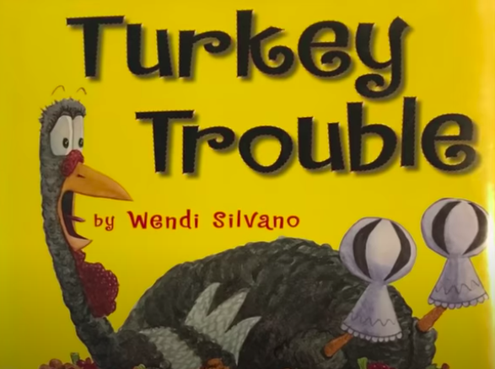
Title of book:
Genre:
Author’s Purpose:
Main Character: Who is the main character in the story?
Setting: Where did the story take place?
Problem: What was the problem in the story?
Solution: How did the main character solve the problem?
Theme: What was the theme of the story?
Think about the book you read/heard. Type in the answer to each of the questions - the answers have been started for you.
Type here
Type here
Type here
The main character was
Story Elements:
Main Character
Setting
Problem
Solution
Theme
The story was set
Click the book cover to complete this assignment by writing the answers in a paragraph.
The problem was
The solution was
The theme was

Slide 4
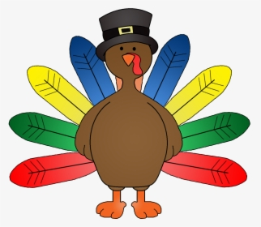
Time to Put it All Together!
Use the sentence starters to write your answers in a paragraph.
SENTENCE STARTERS
The author introduces us to ___.
We meet the main character, ____.
The reader realizes ______.
We notice the story takes place ___.
We discover _______.
We learn the problem is _____.
The author reveals the solution ___.
He/She solves the problem ___.
As the story unfolds we find ____.
The author shows us ______.
Click the turkey to go back to your answers
Type your paragraph here:
Click the book cover to go to an example.

Slide 5
Time to Put it All Together!
Use the sentence starters to write your answers in a paragraph.
SENTENCE STARTERS
The author introduces us to ___.
We meet the main character, ____.
The reader realizes ______.
We notice the story takes place ___.
We discover _______.
We learn the problem is _____.
The author reveals the solution ___.
He/She solves the problem ____.
As the story unfolds we find ____.
The author shows us ______.
Click the turkey to go back to your paragraph.
In the book, Turkey Trouble, the author introduces us to the main character, Turkey. We notice the story takes place on a farm with many animals. The author reveals the problem that the farmer and his wife want to make Turkey their Thanksgiving dinner. As the story unfolds, we see that Turkey tries to use costumes to make himself look like the different animals on the farm but it never works. He solves his problem by delivering a pizza to the farmer and his wife and they eat that instead of turkey dinner. The author shows us the theme of the story is, be creative, as the turkey dresses up and tries to hide himself.

Slide 6
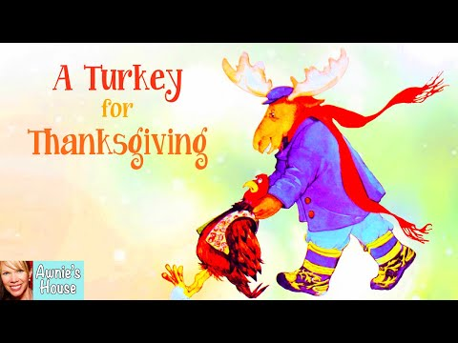

Story Elements:
Main Character
Setting
Problem
Solution
Theme
Here are a few more stories to practice this lesson!

Slide 7
Title of book:
Genre:
Author’s Purpose:
Main Character: Who is the main character in the story?
Setting: Where did the story take place?
Problem: What was the problem in the story?
Solution: How did the main character solve the problem?
Theme: What was the theme of the story?
Type here
Think about the book you read/heard. Type in the answer to each of the questions - the answers have been started for you.
Type here
Type here
The main character was
Story Elements:
Main Character
Setting
Problem
Solution
Theme
The story was set
The problem was
The solution was
The theme was

Slide 8
Time to Put it All Together!
Use the sentence starters to write your answers in a paragraph.
SENTENCE STARTERS
The author introduces us to ___.
We meet the main character, ____.
The reader realizes ______.
We notice the story takes place ___.
We discover _______.
We learn the problem is _____.
The author reveals the solution ___.
He/She solves the problem ___.
As the story unfolds we find ____.
The author shows us ______.
Click the turkey to go back to your answers
Type your paragraph here:

